Slide 1
PRICE SPY
Everything at lowest Price

Slide 2
TEAM-06
PAVANI KARUMURI
GOPI LOKINDI
GANGA PRASANNA MOGAPARTHY
MAHESHWAR PUNYAM ANAND
MENTOR : Dr. RATAN LAL

Slide 3
TABLE OF CONTENTS
Problem Statement
Introduction
Functional Requirements
Non-Functional Requirements
Web-Scraping
Cloud Computing
API
IOS Development

Slide 4

PROBLEM
Prices varies form point to point and time to time !
Hectic thing is finding a damn cheap deal in a short span of time.

Slide 5

PRICE SPY
Here we have come up with a solution by creating an IOS Application which brings the best deals of products from different sites.
It displays the product of specific search with low price and the site in which it is available.

Slide 6
FUNCTIONAL REQUIREMENTS
WEB SCRAPING
CLOUD COMPUTING
DEVELOPMENT ENVIRONMENT(XCODE,PYCHARM,ECLIPSE)
PROGRAMMING LANGUAGES(PYTHON,JAVA,SWIFT)
API

Slide 7
NON FUNCTIONAL REQUIREMENTS
AMAZON ACCOUNT
APPLE ID
APPLE DEVELOPER ACCESS
GIT HUB ACCESS

Slide 8
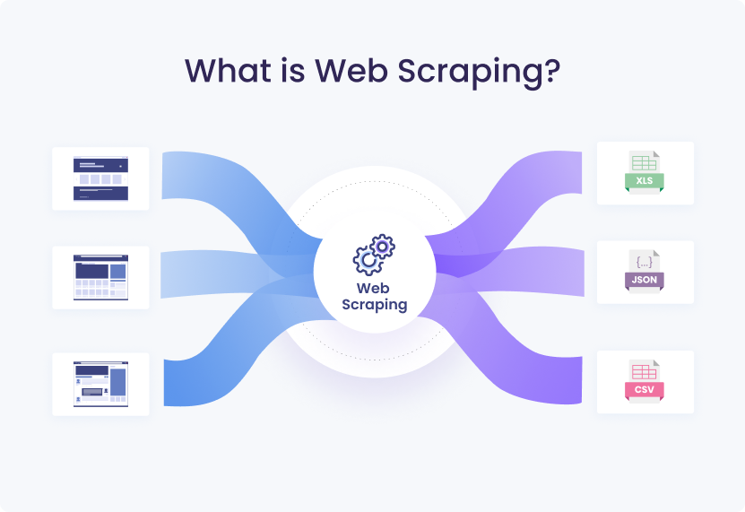
WEB SCRAPING
Web scraping is an automatic method to obtain large amounts of data from websites. Most of this data is unstructured data in an HTML format which is then converted into structured data in a spreadsheet or a database so that it can be used in various applications.

Slide 9

WEB SCRAPING LIBRARIES
Beautiful Soup.
Requests.
Scrapy.
Selenium.
Playwright.
Lxml.
Urllib3.
MechanicalSoup.

Slide 10
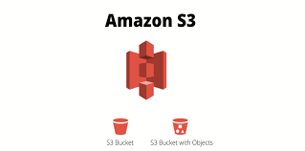
CLOUD COMPUTING
We are using cloud computing for storing the large amount of data that we extract using from different sites.
An S3 Bucket is been used to store these data and been used while integrating with the IOS Application.

Slide 11

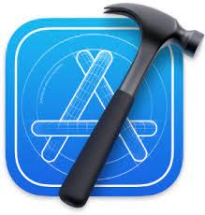

DEVELOPING ENVIRONMENT

Slide 12
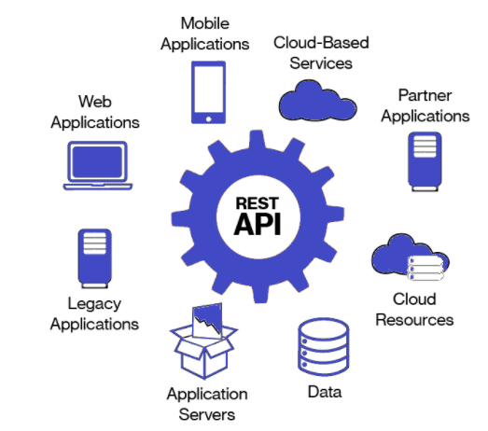
API
API that we have using here is REST API.
RESTful API is an interface that two computer systems use to exchange information securely over the internet. Most business applications have to communicate with other internal and third-party applications to perform various tasks.

Slide 13
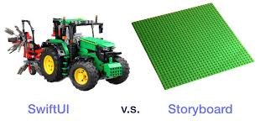
IOS DEVELOPMENT
In Xcode we have two option of designing an IOS Application.
Story Board – It is sample GUI like this where we used to drag and drop elements like CAD,LABVIEW etc.
Swift UI – It is another kind of approach where we use to design the UI and functionality using swift programming entirely.

Slide 14
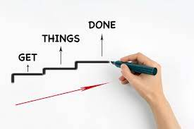
THINGS ACCOMPLISHED
Extracted the links for the products from different sites and stored them in the excel sheets.
Designed a prototype of the feature application design and respective page navigation.
Come up with the flowchart of comparison mechanism of the data and initiated the developing process.

Slide 15
Thank You

